Slide 1
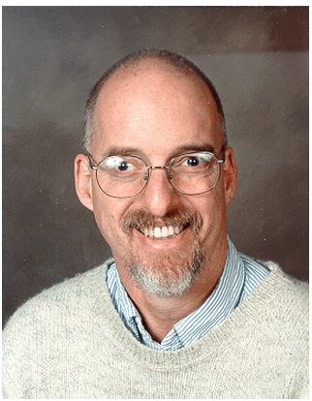
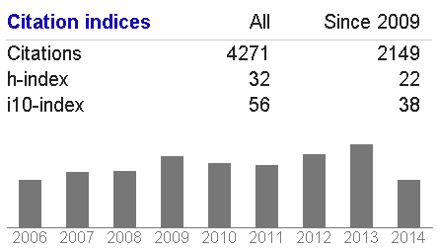
Matthew O. Ward
Professor
Computer Science
WPI
data and information visualization, visual analytics
Selected Publications:
Matthew O. Ward, "XmdvTool: Integrating Multiple Methods for Visualizing Multivariate Data", IEEE Visualization 1994 Proceedings, October 1994, pp 326-333.
Ying-Huey Fua, Matthew O. Ward, and Elke A. Rundensteiner, "Hierarchical parallel coordinates for exploration of large datasets", IEEE Visualization Conference 1999: celebrating ten years, October 1999, pp 43-50.
Jeffrey LeBlanc, Matthew O. Ward, and Norman Wittels, "Exploring n-dimensional databases", IEEE Visualization 1990 Proceedings, October 1990, pp 230-237.

Slide 2
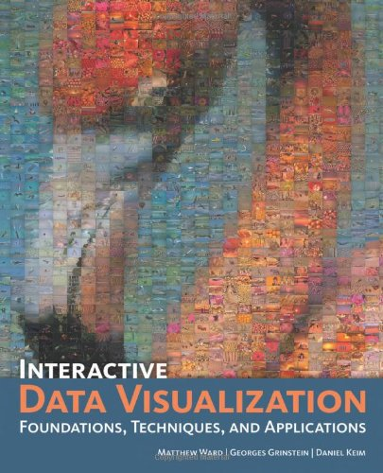
Interactive Data Visualization: Foundations, Techniques, and Application

Slide 3
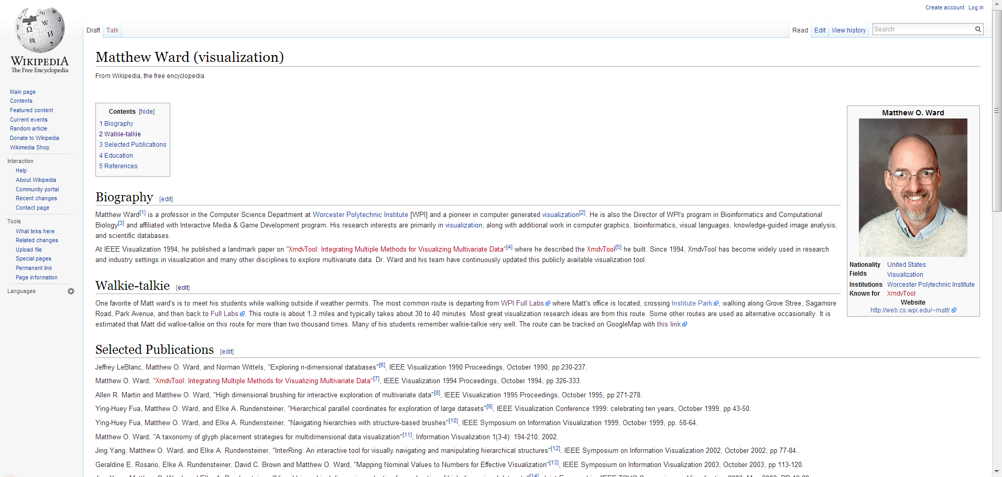
Matt is on Wikipedia!

Slide 4
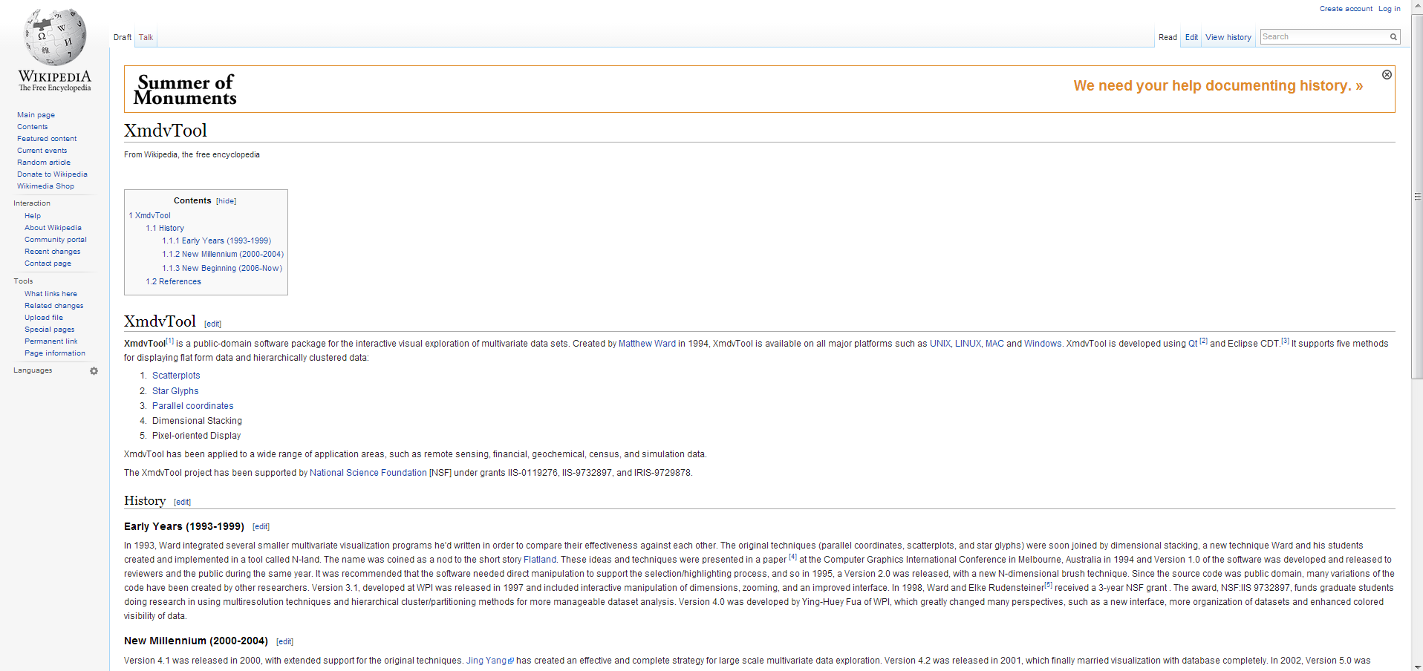
XmdvTool is also on Wikipedia

Slide 5
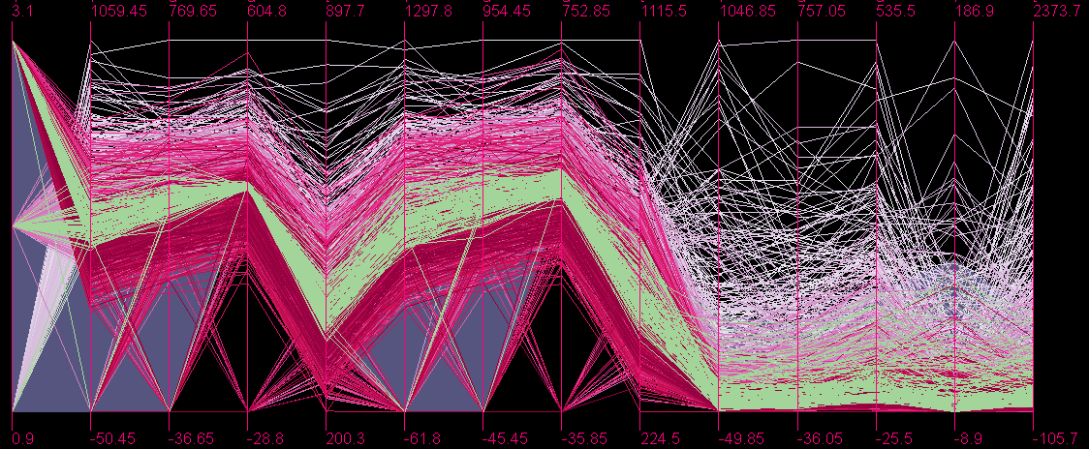
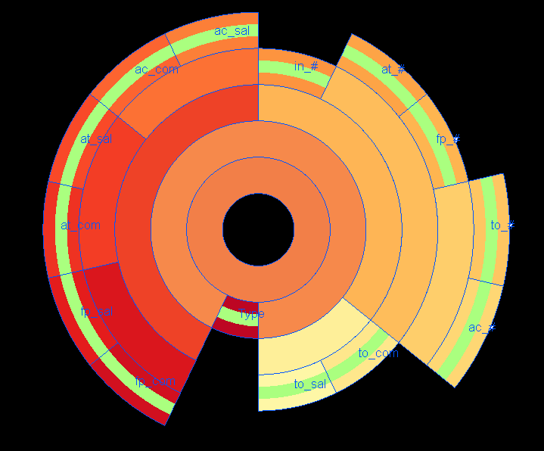
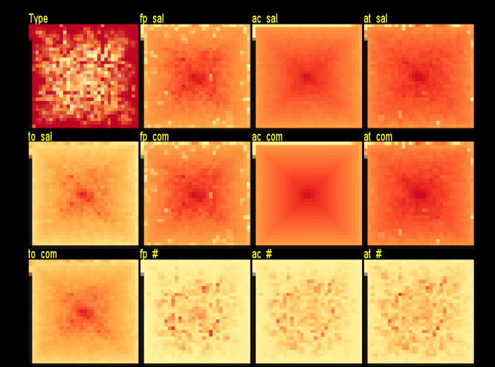
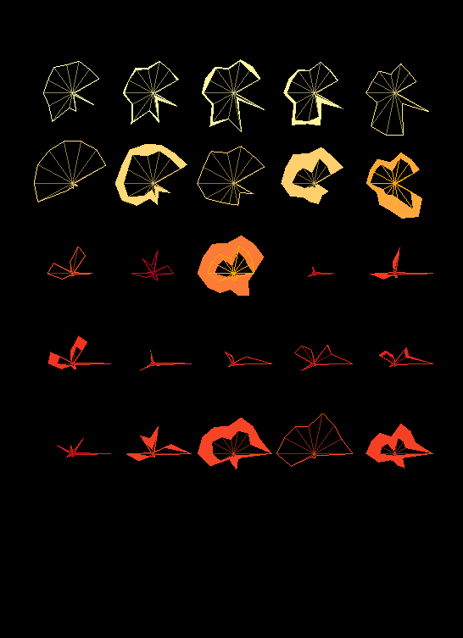
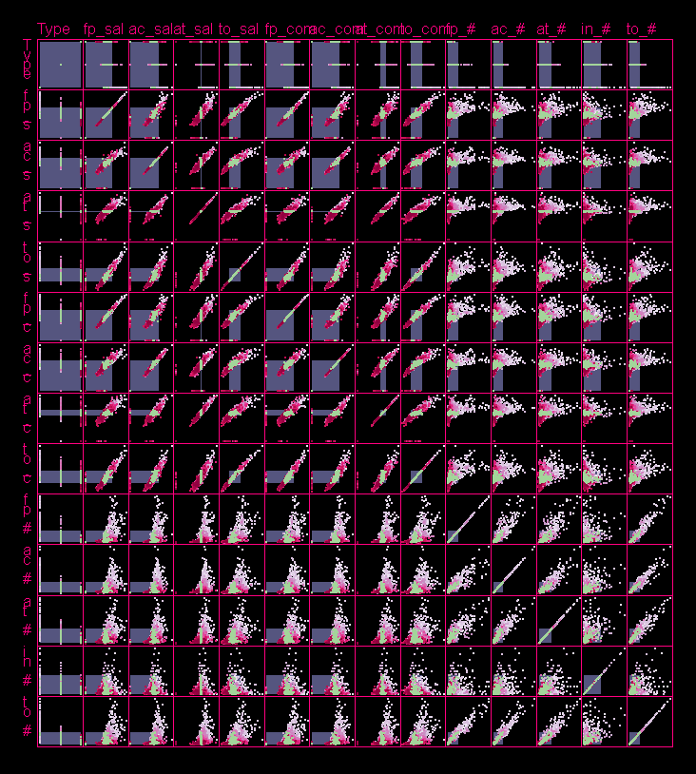
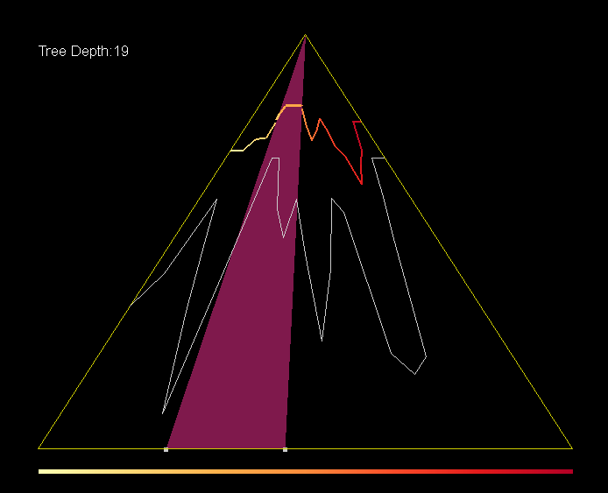
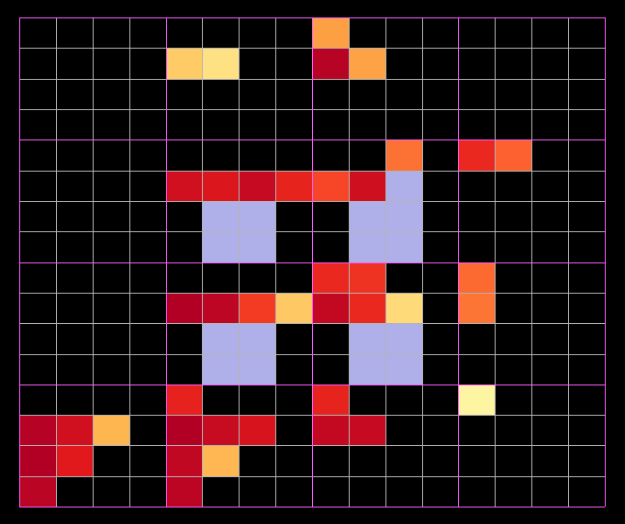
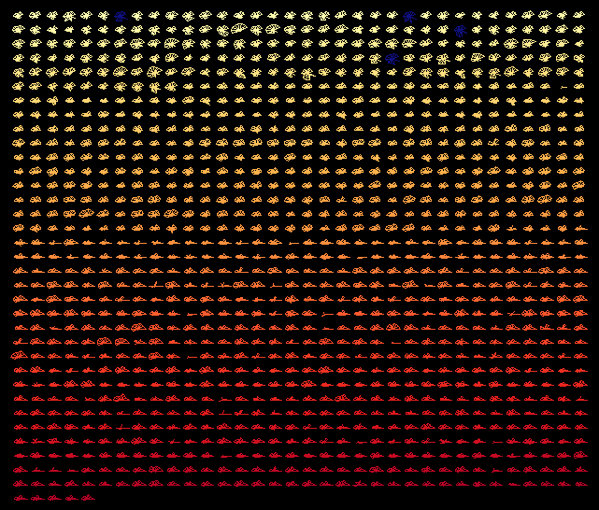
XmdvTool
20 Years Since 1994
“It is always exciting to work with others … to see their data in new ways … and help them understand their data in a way that is much richer…”
— Matthew O. Ward

Slide 6
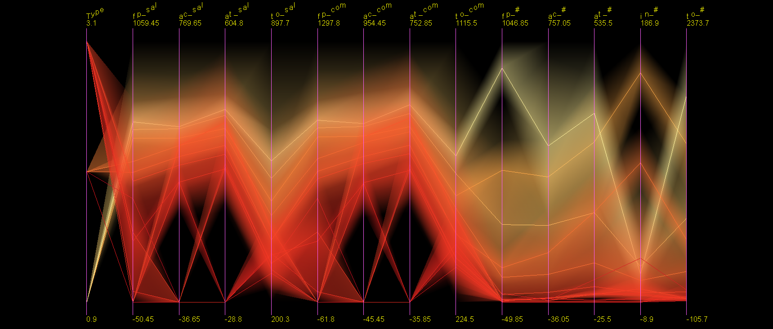
Hierarchical Parallel Coordinates
Statistical aggregation
Proximity based coloring translucency
Dimension zooming
Extent scaling
Dynamic masking

Slide 7
Research Grants
Hierarchical Visualization Techniques for Data Mining (IIS-9732897)
Principal Investigator: Matthew Ward
Co-Principal Investigator: Elke Rundensteiner
Amount: $311,804.00
Y. Fua, M. O. Ward, and E. A. Rundensteiner. "Navigating Hierarchies with Structure-Based Brushes", 09/01/1998-08/01/1999, "Proc. IEEE Symposium on Information Visualization", 1999, "IEEE Computer Society Press". Y. Fua, M. O. Ward, and E. A. Rundensteiner. "Hierarchical Parallel Coordinates for Visualizing Large Multivariate Data Sets", 09/01/1998-08/01/1999, "Proc. IEEE Conference on Visualization", 1999, "IEEE Computer Society Press". Y. Fua. "Hierarchical Parallel Coordinates", 09/01/1998-08/01/1999, 1999, "M.S. Thesis, WPI Computer Science Department". Y. Fua. "Hierarchical Parallel Coordinates", 09/01/2000-08/01/2001, 1999, "M.S. Thesis, WPI Computer Science Department". Daniel Stroe. "Scalable Visual Hierarchy Exploration", 09/01/2000-08/01/2001, 2000, "M.S. Thesis, Worcester Polytechnic Institute Computer Science Department".
…(More)

Slide 8
Flat Parallel Coordinates
Create mapping between multivariate tuples and polylines
Range brushing
Zoom in/out

Slide 9
Research Grants
Large-Scale Data Visualization and Management (IRIS-9729878)
Principal Investigator: Matthew Ward
Co-Principal Investigator: Maria Cruz & Elke Rundensteiner
Amount: $68,000.00
I. F. Cruz (Founding editor). "ACM SIGMOD Digital Symposium Collection", 01/01/1998-12/31/2000, , I. F. Cruz (Founding editor)"ACM SIGMOD Digital Symposium Collection", 1999, "ACM". I. F. Cruz. "Special Issue on User Interfaces for Digital Libraries", 01/01/1998-12/31/2000, 1999, "Int. J. on Digital Libraries 2(2-3), 1999". I. F. Cruz, Kim Marriott, Pascal Van Hentenryck. "Special Issue on Constraints for Graphics and Visualization", 01/01/1998-12/31/2000, 1998, "Constraints 3(1) 1998". E. A. Rundensteiner, Associate Editor. "Special Issue on Database Transformation Technology", 01/01/1998-12/31/2000, 1999, "IEEE Data Engineering Bulletin,IEEE, March 1999". E. A. Rundensteiner, Associate Editor. "Special Issue on Database Technology for E-Commerce", 01/01/1998-12/31/2000, 2000, "IEEE Data Engineering Bulletin, IEEE, March 2000.".

Slide 10
Visual Hierarchical Dimension Reduction
Representative dimensions
Interactive hierarchical displays
Database backend with minmax encoding
Semantic caching and adaptive prefetching

Slide 11
Pixel Oriented Display
Linked N-dimensional brushing
Query range specification
Dimension distortion
Manual pixel reordering

Slide 12
Research Grants
Managing Discoveries in Visual Analytics(IIS-0812027)
Principal Investigator: Matthew Ward
Co-Principal Investigator: Elke Rundensteiner
Amount: $477,849.00
Di Yang, Elke Rundensteiner, and Matthew Ward. "Summarization and matching of density-based clusters in streaming environments," PVLDB, v.5, 2012, p. 121. Di Yang, Avani Shastri, Elke A. Rundensteiner, Matthew O. Ward:. "An optimal strategy for monitoring top-k queries in streaming windows," EDBT, v.1, 2011, p. 57. Zhenyu Guo, Matthew Ward, Elke Rundensteiner, and Carolina Ruiz. "Evaluation of a pointwise local visual exploration method," Tsinghua Science and Technology, v.17, 2012. D. Yang, Z. Xie, E. Rundensteiner, and M. Ward. "Managing discoveries in the visual analytics process," ACM SIGKDD Explorations (special issue on Visual Analytics), v.9, 2007, p. 22. Di Yang, Elke A. Rundensteiner, Matthew O. Ward. "Analysis Guided Visual Exploration to Multivariate Data," IEEE Symposium on Visual Analytics, Science and Technology, 2007, p. 1.
… (More)

Slide 13
Hierarchical Starglyph Display
Cluster extend representation
Cluster structure comparison
Efficient space usage
Interactive with other views

Slide 14
Flat Starglyph Representation
Shape evolution representation for trends and anomalies

Slide 15
Research Grants
Managing Discoveries in Visual Analytics(IIS-0812027)
Principal Investigator: Matthew Ward
Co-Principal Investigator: Elke Rundensteiner
Amount: $477,849.00
Di Yang, Elke Rundensteiner, and Matthew Ward. "Summarization and matching of density-based clusters in streaming environments," PVLDB, v.5, 2012, p. 121. Di Yang, Avani Shastri, Elke A. Rundensteiner, Matthew O. Ward:. "An optimal strategy for monitoring top-k queries in streaming windows," EDBT, v.1, 2011, p. 57. Zhenyu Guo, Matthew Ward, Elke Rundensteiner, and Carolina Ruiz. "Evaluation of a pointwise local visual exploration method," Tsinghua Science and Technology, v.17, 2012. D. Yang, Z. Xie, E. Rundensteiner, and M. Ward. "Managing discoveries in the visual analytics process," ACM SIGKDD Explorations (special issue on Visual Analytics), v.9, 2007, p. 22. Di Yang, Elke A. Rundensteiner, Matthew O. Ward. "Analysis Guided Visual Exploration to Multivariate Data," IEEE Symposium on Visual Analytics, Science and Technology, 2007, p. 1.
… (More)

Slide 16
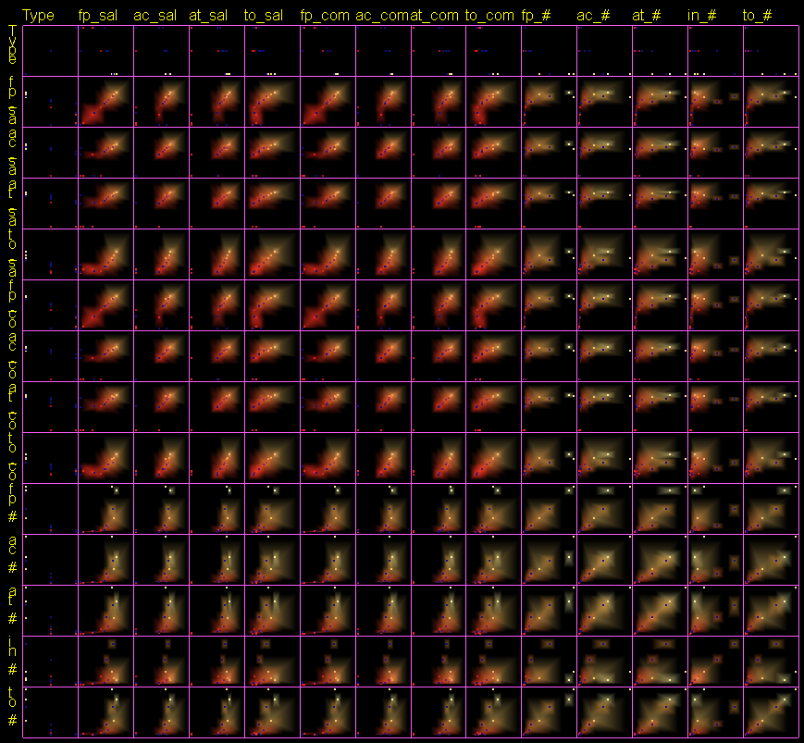
Hiearchical Scatter Plot
Cluster visualization for each 2D projection

Slide 17
Flat Scatterplot Matrices
Small multiple views
2-D relation rendering
View interpretability optimization
Interactive range selection

Slide 18
Research Grants
Order, Spacing, and Clustering in Visual Exploration of Large Scale Data(IIS-0119276)
Principal Investigator: Matthew Ward
Co-Principal Investigator: Elke Rundensteiner
Amount: $640,320.00

Slide 19
Structure Based Brushing
Hierarchical tree frame
Contour representation for level-of-detail
Contour adjustment
Approximation of hierarchical tree

Slide 20
Research Grants
Quality Space Visualization (IIS-0414380)
Principal Investigator: Matthew Ward
Co-Principal Investigator: Elke Rundensteiner
Amount: $384,000.00
Jing Yang. "A General Framework for Multi-Resolution Visualization," dissertation, WPI, April 2005, etd-050505-113345, 2005, p. 1. Shiping Huang. "Exploratory Visualization of Data with Variable Quality," MS Thesis, Worcester Polytechnic Institute Computer Science Department, 2005, p. 1. Qingguang Cui. "Measuring Data Abstraction Quality in Multiresolution Visualizations," M.S. Thesis, Worcester Polytechnic Institute, Computer Science Department, 2007, p. 1. Wei Peng. "Clutter-Based Dimension Reordering in Multi-Dimensional Data Visualization," M.S. Thesis, Worcester Polytechnic Institute Computer Science Department, 2005, p. 1. Qingguang Cui, Matthew Ward, and Elke A. Rundensteiner. "Measuring Data Abstraction Quality in Multiresolution Visualization," IEEE Transactions on Visualization and Computer Graphics, v.12, 2006, p. 709.
…(More)

Slide 21
Dimensional Stacking
Multivariate data density representation
Recursive data partitioning
Data binning optimization

Slide 22
Research Grants
Interactive Stream Views: Visual Analysis of Streaming Data (CCF-0811510)
Principal Investigator: Matthew Ward
Co-Principal Investigator: Elke Rundensteiner
Amount: $299,968.00
Zaixian Xie. "Towards Exploratory Visualization of Multivariate Streaming Data," IEEE Vis/InfoVis/VAST Doctoral Colloquium, v.1, 2007, p. 1. D. Yang, A. Shastri, E. Rundensteiner, M. Ward. "An optimal strategy for monitoring top-k queries in streaming windows," Proc. EDBT, 2011, p. 57. Yang, Di, Rundensteiner, E.A., and Ward, M.. "Neighbor-Based Pattern Detection for Windows Over Streaming Data," Extending Database Technology (EDBT), v.1, 2009, p. 1. Z. Xie, M. O. Ward, and E. A. Rundensteiner. "Exploring multivariate data streams using windowing and sampling strategies," Interacting with Temporal Data, CHI'2009 Workshop, v.1, 2009, p. 1. Xie, Z., Ward, M.O., and Rundensteiner, E.A.. "Visual exploration of stream pattern changes using a data-driven framework," Proc. International Symposium on Visual Computing, 2010, p. 522.
…(More)

Slide 23
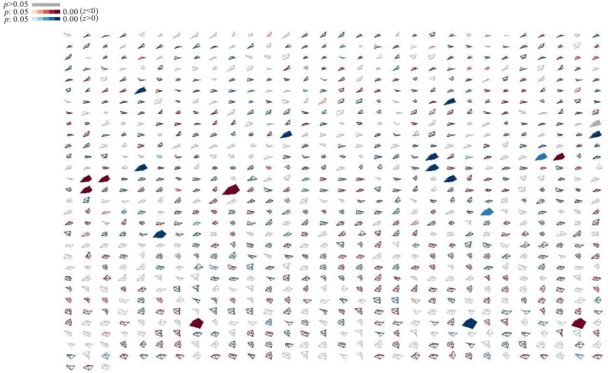
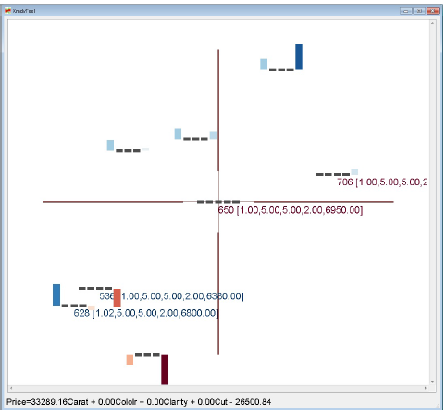
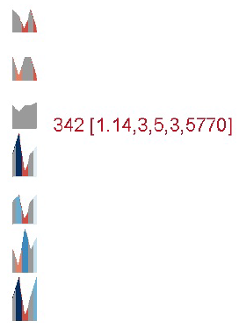
Research Grants
Model-Driven Visual Analytics on Streams (IIS-1117139)
Principal Investigator: Matthew Ward
Co-Principal Investigator: Huong Higgins & Elke Rundensteiner
Amount: $515,918.00
Yang, Di; Rundensteiner, Elke A.; Ward, Matthew O.. "Mining neighbor-based patterns in data streams," INFORMATION SYSTEMS, v.38, 2013, p. 331-350. Z. Guo, M. Ward, E. Rundensteiner, and C. Ruiz. "Evaluation of a Pointwise Local Visual Exploration Method," Tsinghua Science and Technology, v.17, 2012, p. 429-439. Yang, Di; Rundensteiner, Elke A.; Ward, Matthew O.. "Multiple Query Optimization for Neighbor-Based Pattern Mining Requests over Data Streams," ACM TRANSACTIONS ON DATABASE SYSTEMS, v.37, 2012, p. 43.

Slide 24
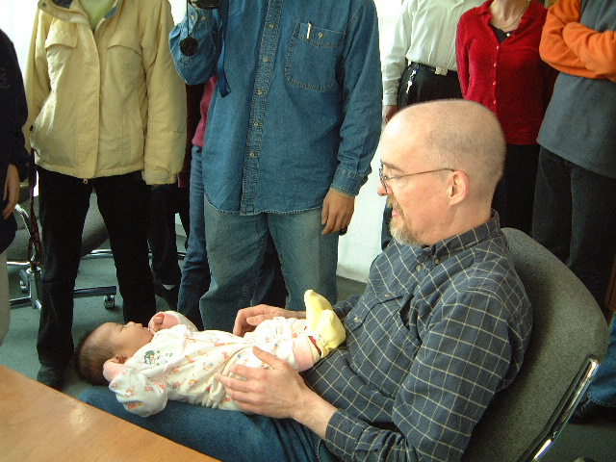
Matt’s Students & Their Babies ☺

Slide 25
Matt’s Students
abhishek.mukherji@gmail.com; amanda.jamin@gmail.com; AMartin@nvidia.com; anil@anilkpatro.com; avani.shastri@oracle.com; benj.lipchak@gmail.com; boydjr7@gmail.com; Caixia.Jiang@amd.com; charudatta.wad@gmail.com; chris.bentley@amd.com; debbiepeng@gmail.com; di.yang@oracle.com; gad@ifdi.net; gerosario@yahoo.com; howraf@gmail.com; jayeshg@gmail.com; jeffl@ics.com; Jing.Yang@uncc.edu; john.bernard@covidien.com; johnrasku@yahoo.com; josh.cui@gmail.com; kaiyu.zhao@gmail.com; kenh@microsoft.com; kenh@microsoft.com; nblloyd@gmail.com; punitdoshi@gmail.com; quyendon@gmail.com; ravi@0sum.org; richard.resnick@genomequest.com; Rtipnis@gmail.Com; shiping@alum.wpi.edu; suresh@paragon-systems.com; walsht@gmail.com; xiezaixian@hotmail.com; xika@WPI.EDU; xqin@cs.wpi.edu; zhenyguo@gmail.com; yinghuey.fua@facebook.com;
Contributions of current students:
Kaiyu Zhao
Xiao Qin
Xika Lin

